Slide 1
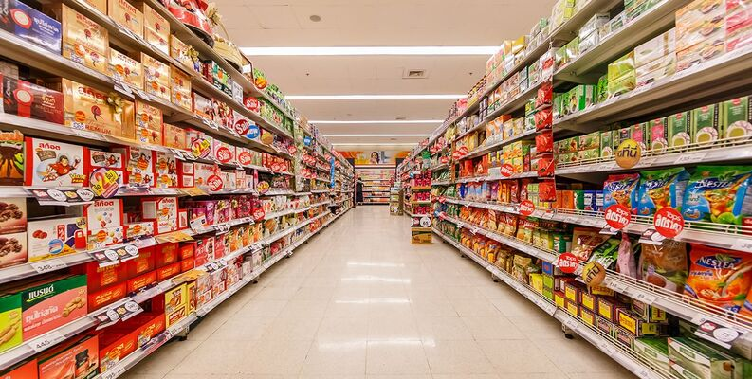
Supermarket Store Branches Sales Analysis
Guided By:- Present By:-
Deepak Gurav Sir. Prachi Sonawane.

Slide 2
Abstract
The Project “supermarket” deals with the automation of supermarket This software will help sales persons in managing the various types of Records pertaining to his/her customer. The product will help the user to work in a highly effective and efficient environment. The salespersons have been recording the customer information in the past and even in the present through their personal manual efforts. And indeed, it consumes their considerable time and energy that could be utilized in the better productive activities. Future sales forecasting is a crucial component of every organization. Accurate prediction of future sales help companies to develop and improve business strategies as well as to gain proper market knowledge. Standard sales projections let companies analysis historical scenarios and then apply client purchases. Before budgeting, inferences are used to detect shortfalls and weaknesses, as well as to construct a good strategy for the following year. A detailed knowledge of past opportunities permits one to plan for future market needs and increase the possibility of success.

Slide 3
Inspiration
Analyzing the performances of stores in the past on basis of which will try to rectify defects as well as to leverage the positives. Who doesn't want to increase their profits right?

Slide 4
About Dataset
A supermarket is a self-service shop offering a wide variety of food, beverages and household products, organized into sections. This kind of store is larger and has a wider selection than earlier grocery stores, but is smaller and more limited in the range of merchandise than a hypermarket or big-box market. In everyday U.S. usage, however, "grocery store" is synonymous with supermarket, and is not used to refer to other types of stores that sell groceries.

Slide 5
import pandas as pd
import numpy as np
import matplotlib.pyplot as plt
%matplotlib inline
Preprocessing
from sklearn.model_selection import cross_val_score, KFold
from sklearn.preprocessing import StandardScaler
Models
from sklearn.linear_model import LinearRegression
from sklearn.ensemble import RandomForestRegressor
from sklearn.model_selection import train_test_split
from sklearn.svm import SVR
Model Evaluation
from sklearn.metrics import mean_absolute_error, mean_squared_error, r2_score

Slide 6
The head function is used to get the first n rows. df = pd.read_csv("D:\Stores.csv") df.head()
Store ID | Store_Area | Items_Available | Daily_Customer_Count | Store_Sales
0 | 1 | 1659 | 1961 | 530 | 66490
1 | 2 | 1461 | 1752 | 210 | 39820
2 | 3 | 1340 | 1609 | 720 | 54010
3 | 4 | 1451 | 1748 | 620 | 53730
4 | 5 | 1770 | 2111 | 450 | 46620

Slide 7
df.shape:- Check shape
df.info:-It gives a quick overview of the dataset
df.isnull().sum():-check missing values
df.describe():-display a statistical summary
df.isna().sum():-Used to detect missing values
df1['sex'].value_counts()
df1.region.value_counts()
df.columns:-Check columns
df.Avgs:-Check Average

Slide 8
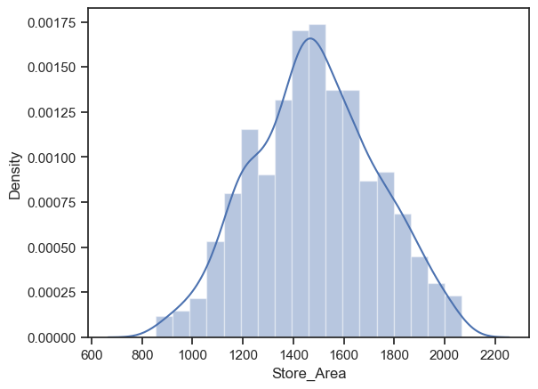
The graph define Store Area sns.color_palette("rocket") sns.distplot(df['Store_Area'])

Slide 9
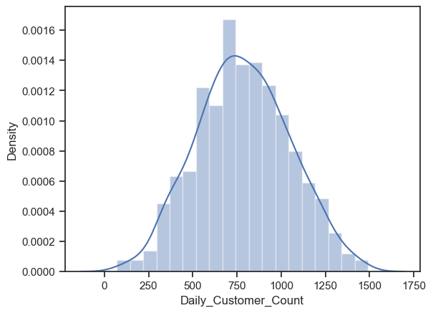
The graph define Customer Count sns.distplot(df['Daily_Customer_Count'])
AxesSubplot:xlabel='Daily_Customer_Count', ylabel='Density'>

Slide 10
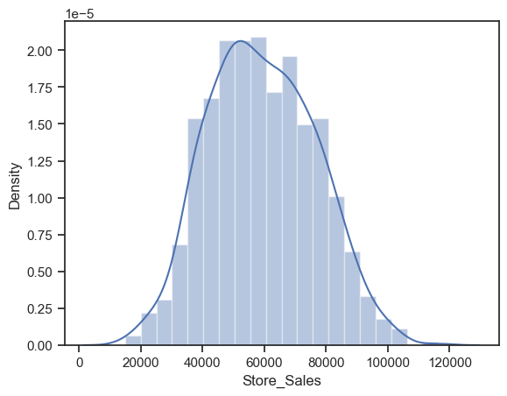
The graph define Store Sales sns.distplot(df['Store_Sales’]) AxesSubplot:xlabel='Store_Sales', ylabel='Density'>

Slide 11
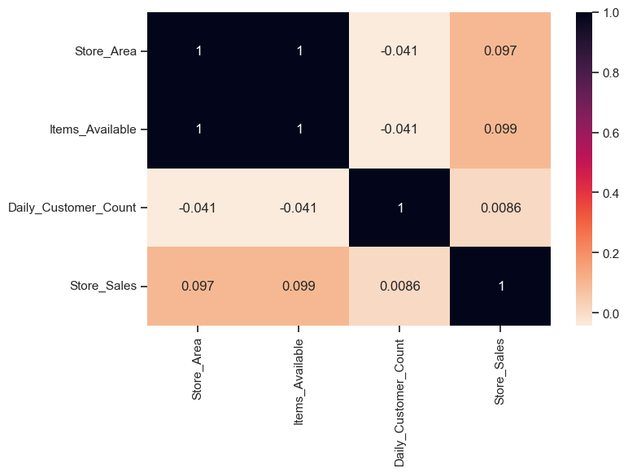
plt.figure(figsize = (8, 5)) sns.heatmap(df.corr(), annot = True, cmap = 'rocket_r')
<:
AxesSubplot

Slide 12
Data Preprocessing
y = df['Store_Sales']
X = df.drop('Store_Sales',axis=1)
X_train, X_test, y_train, y_test = train_test_split(X, y, test_size = 0.20, random_state = 42)
sc = StandardScaler()
X = sc.fit_transform(X)
print('Shape of X_train = ', X_train.shape)
print('Shape of y_train = ', y_train.shape)
print('Shape of X_test = ', X_test.shape)
print('Shape of y_test = ', y_test.shape)
OUTPUT:-
Shape of X_train = (716, 3)
Shape of y_train = (716,)
Shape of X_test = (180, 3)
Shape of y_test = (180,)
# Modeling after clustering
#Linear Regression
lr = LinearRegression()
lr.fit(X_train, y_train)
lr_pred =lr.predict(X_test)

Slide 13
Linear Regression
print('Linear Regression')
print("MSE: %.2f" % mse)
print("RMSE: %.2f" % (rmse))
print("MAE: %.2f" % (mae))
print("Training score: ", score)
print("Mean cross-validation score: %.2f" % scores.mean())
print("K-fold CV average score: %.2f" % kf_cv_scores.mean())
print("R_score : %.2f"%(r2))
OUTPUT
Linear Regression
MSE: 361540811.28
RMSE: 19014.23
MAE: 15735.40
Training score: 0.8430787450156397
Mean cross-validation score: -0.13
K-fold CV average score: -0.14
R_score : -0.88

Slide 14
THANK YOU…

